Slide 1
FIN 740: Corporate Finance
Topic #6
Bond & Stock Valuation

Slide 2
Outline for this topic
Discuss how to value two other assets using DCF method
Corporate bonds
Stocks
Discuss institutional details of these two markets
Apply tools using “Warren Buffett” case [again]

Slide 3
Motivation for studying bond market & valuation
Fact #1: Market is massive; e.g., at end of 2018, there were $42 trillion in bonds outstanding in US alone
Fact #2: While stock markets get a lot of attention, US debt market is twice the size of all US stock markets combined
I.e., corporations rely (a lot) on bonds for financing
And investors (like you), own them
So, knowing how this market works and how to value these bonds is important

Slide 4
Outline of corporate bond discussion
What is a bond & basic terminology
Using DCF to value bonds
General information about bond market

Slide 5
What is a bond?
Bonds are basically interest-only loans
Issuer pays interest (i.e., coupon) each period until maturity
And at maturity, issuer pays principal (i.e., face value)
E.g., a company might issue a bond with a face value of $1,000, an annual coupon of $60, and maturity of 10 years. This means…
Bond will pay $60 per year for first 9 years
In 10th year, bond will pay $60 + $1,000 = $1,060

Slide 6
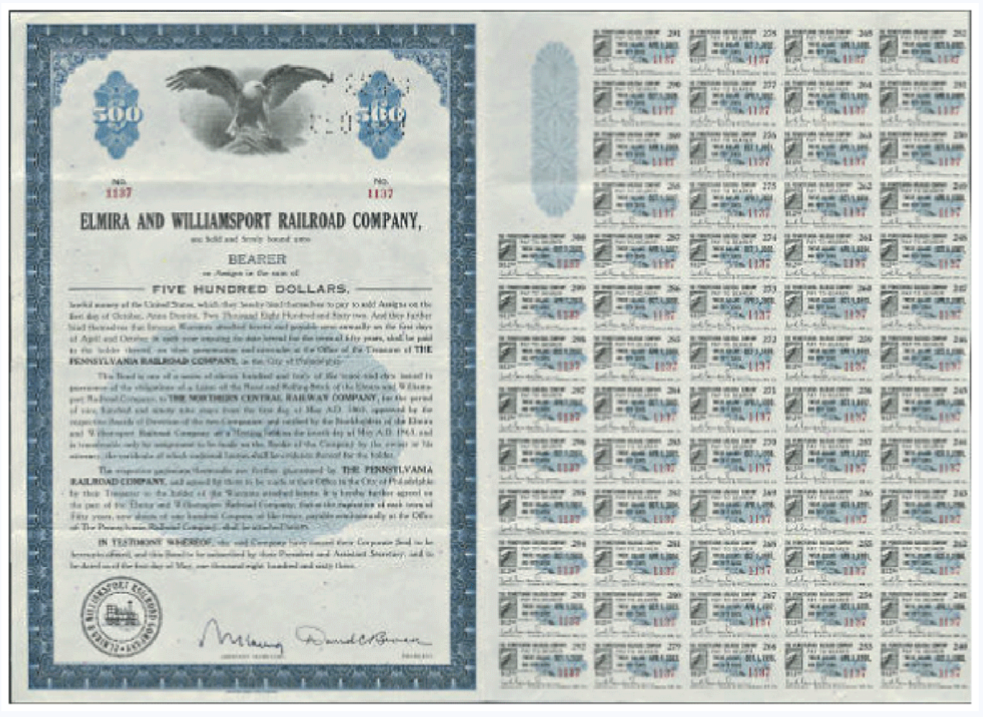
The bond certificate
It states the terms of a bond as well as the amounts and dates of all payments to be made
Anyone know what the small, repeated images here are?
Figure 6.1: Berk, Demarzo, and Harford, Fundamentals of Corporate Finance, 5th Ed.

Slide 7
Bond terminology
Coupon = promised interest payment each period
Face value = amount bond pays at maturity [Also called par value]
Maturity date = final repayment date
Coupon rate = annual coupon of bond divided by its face value
E.g., bond with $1,000 face value that pays a $25 coupon twice a year (i.e., semiannually) would have a stated coupon rate of (25 + 25) / 1000 = 5%.
Next, let’s talk about valuation… How do you think investors determine how much is most they should pay to buy a bond?

Slide 8
Valuing a bond using DCF
The amount investors will be willing to pay to own a bond should equal present value of expected cash flows
I.e., can value bonds using DCF just like any other asset!
First, identify the expected cash flows and create timeline
Then, take present value using correct discount rate
Let’s work through an example… 10-year bond with annual coupon of $60 & face value of $1,000. We will assume appropriate discount rate is 6%.

Slide 9
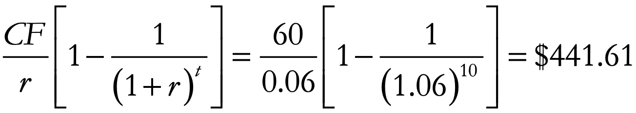
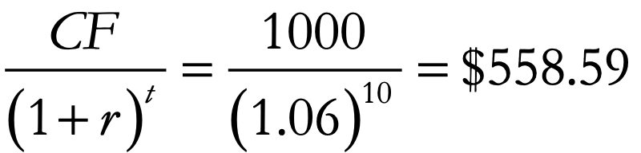
Example bond valuation
Using timeline, I break it into two cash flow streams (CFS)
Value of CFS₁ =
Value of CFS₂ =
So, bond is worth 441.61 + 558.59 = $1,000
What valuation shortcut did I use here?
$1,000 is not a coincidence! More later…

Slide 10
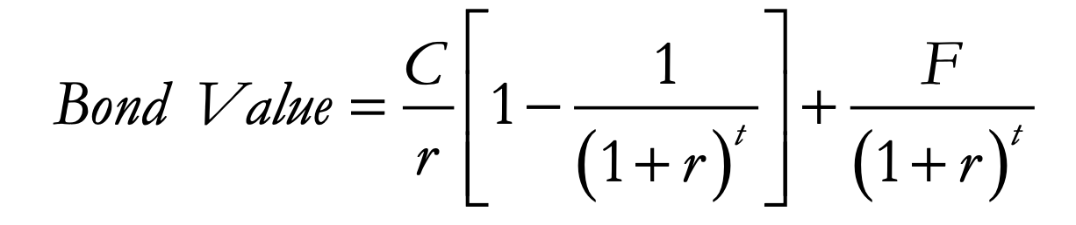
Bond valuation formula
In general, can value bond using following formula
C = coupon
F = face value of bond
t = years until maturity
r = appropriate discount rate
Present value of face value payment at maturity
Present value of coupons

Slide 11
The appropriate discount rate…
As discussed before, the discount rate should reflect the riskiness of the expected payments and investors’ opportunity cost
However, if we replace “bond value” with the bond’s market price, P, and instead use this formula to solve for r, what do we call the resulting r?

Slide 12
Yield to Maturity (YTM)
YTM = discount rate, r, that sets present value of promised bond payments equal to the current market price of the bond
I.e., it is the internal rate of return (IRR) an investor will receive if they buy the bond at its current price given its coupons, etc.
Can also think of it as the return demanded by investors buying the bond at that price (i.e., their required return)
Can use IRR formula in MS Excel to solve for YTM; see Topic #3 for details on using that formula

Slide 13
How the YTM is useful…
Calculating the yield curve [see topic #5]
Yield curve (i.e., the interest rate paid by the US government for bonds of different maturities) is calculated using the YTM of US gov’t bonds!
Finding firm’s cost of debt, r_{d}, for WACC [see topic #5]
YTM on a firm’s bonds can be used to find the return the firm must pay investors to make them willing to hold the risky debt!

Slide 14
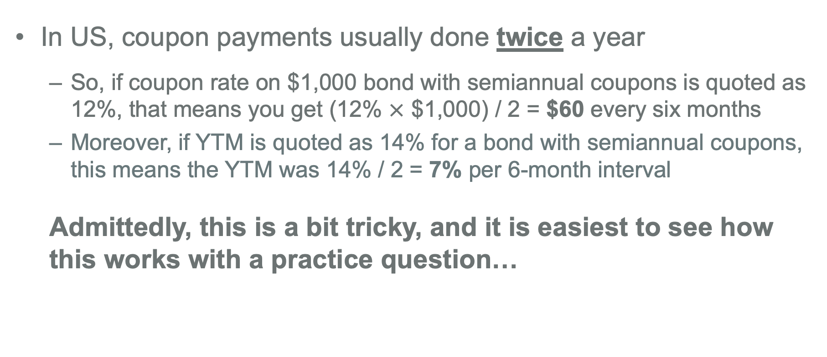
How to handle semiannual coupons
In US, coupon payments usually done twice a year
So, if coupon rate on $1,000 bond with semiannual coupons is quoted as 12%, that means you get (12% $×$ $1,000) / 2 = $60 every six months
Moreover, if YTM is quoted as 14% for a bond with semiannual coupons, this means the YTM was 14% / 2 = 7% per 6-month interval
Admittedly, this is a bit tricky, and it is easiest to see how this works with a practice question…

Slide 15
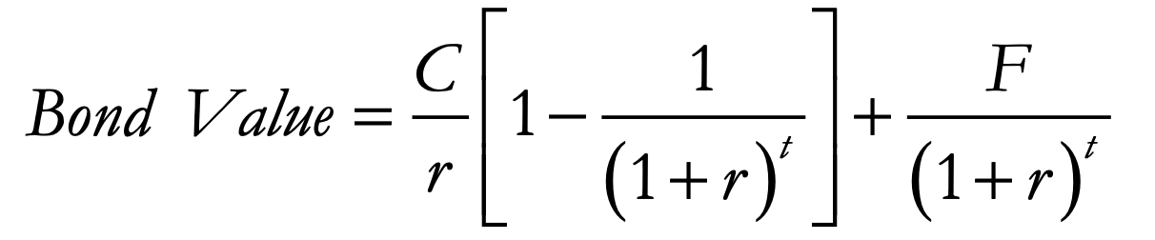
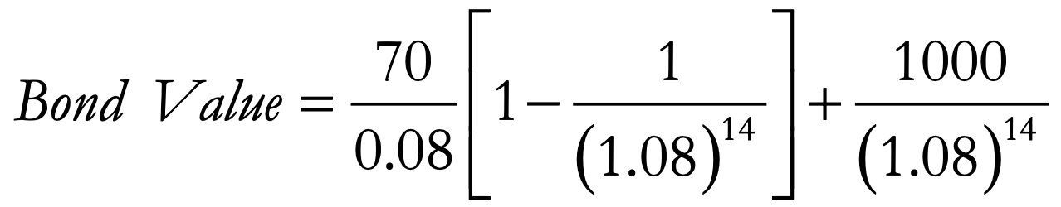
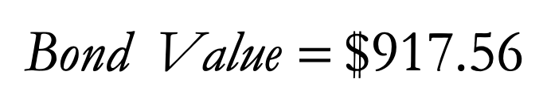

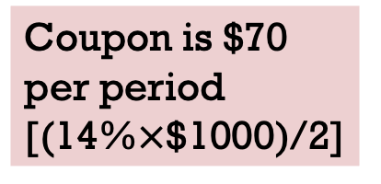
Example valuation with semiannual coupons…
What is the price (i.e., value) of a 7-year $1,000 bond that has semiannual payments, coupon rate of 14%, and a YTM of 16%?
Coupon is $70 per period
[(14%$×$$1000)/2]
YTM is 16%/2 = 8% for each period
# of periods is 7 years $×$ 2 payments a year = 14

Slide 16
Practice question – Finding YTM
Please take 10 minutes to answer the below question [which is based on examples 6.3 and 6.4 of the textbook]
Consider a five-year, $1,000 bond with a 2.2% coupon rate and semiannual coupons. If this bond is currently trading for a price of $963.11, what is the bond’s yield to maturity?
Hint: You should first create a timeline of promised cash flows. Then, you should use IRR function in MS Excel to solve for what the IRR will be if pay $963.11 to get this stream of cash flows.

Slide 17
Practice question – Valuing a bond
Now, please take 10 minutes to answer the below question [which is based on example 6.5 of the textbook]
Using the same information as last question, now suppose the YTM of the bond drops to 2%... what will the new bond price be?
And explain why the bond price changes in the direction that it does. I.e., if it rises, explain why. If it falls, explain why.

Slide 18
Bond prices and yields
Bond prices and interest rates (i.e., the YTM demanded by investors) are always inversely related
As interest rates rise, investors discount the future cash flow stream more (i.e., value it less), and the bond’s price will fall
As interest rates fall, investors discount the future cash flow stream less (i.e., value it more), and the bond’s price will rise
Key point = a bond’s coupon & face value does not change over time; only our value of them changes

Slide 19
General information about bond markets
Let’s now finish our discussion of bonds with some additional information about bond markets
Bond price terminology
Zero-coupon bonds
US Treasury terminology
Corporate bonds, credit ratings, credit spreads
Where to find bond price information?

Slide 20
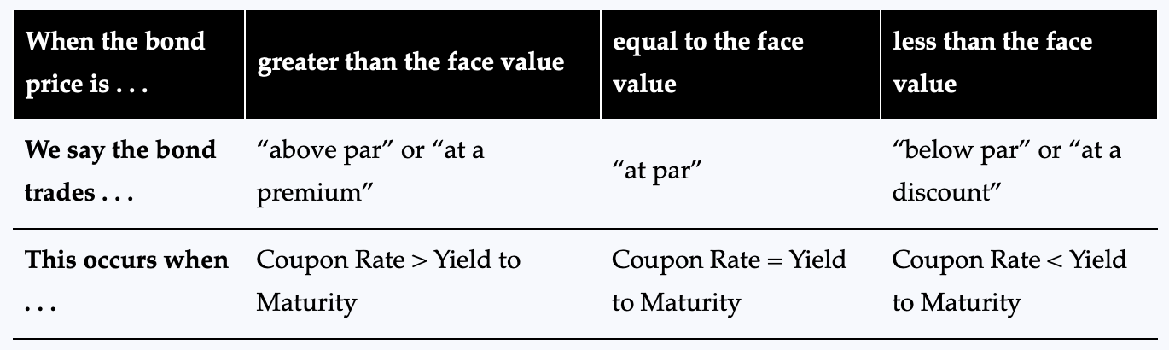
Bond price terminology
A bond is said to be selling at…
Discount if price is less than face value
Par if the price is equal to the face value
Premium if price is greater than face value
Whether coupon rate exceeds YTM determines this…
Most firms set coupon rate such that bonds initially sell at par value [How?]
Table 6.3: Berk, Demarzo, and Harford, Fundamentals of Corporate Finance, 5th Ed.

Slide 21
Zero-coupon bonds
These bonds do not make any coupon payments; they only return principal (the face value) at maturity
Investors’ compensation is difference between price & the face value
E.g., a zero-coupon bond with $100,000 face value that matures in one year might have an initial price of $99,910
When issued, will these bonds sell at a discount or premium?
And does anyone know a classic example of such a bond?

Slide 22
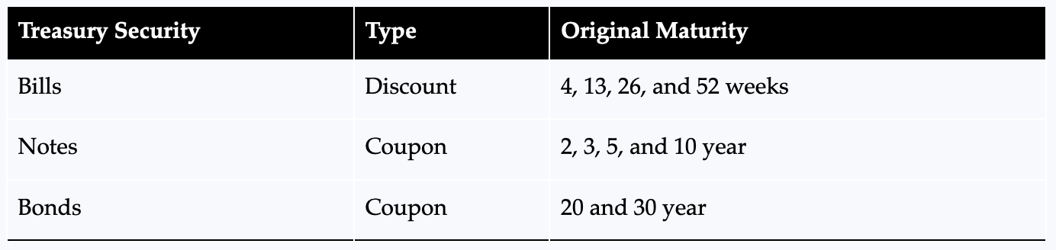
US Treasuries [the risk-free benchmark]
For US Treasuries, the different names (“bill” vs. “note” vs. “bond”) refer to the types of US government bonds
Table 6.2: Berk, Demarzo, and Harford, Fundamentals of Corporate Finance, 5th Ed.
“Discount” is another term for “zero-coupon”

Slide 23
Corporate bonds & credit risk
Corporate bonds are bonds issued by companies
These bonds have a risk of default (i.e., “credit risk”), and hence, will provide a higher expected return
Also, bond coupons are “promised” payments, and not necessarily what investors “expect” to receive
Likewise, YTM is “promised” yield, and not necessarily what investors’ “expected return”

Slide 24
Bond ratings
Credit rating agencies (e.g., S&P, Moody’s, and Fitch) rate bonds based on likelihood of default; e.g., for S&P…
AAA [highest rating, least risk of default]
AA
A
BBB
BB
B
CCC
CC
C [lowest rating, greatest risk of default]
“Investment grade” bonds
These are referred to as “junk,” “high-yield,” or “speculative” bonds

Slide 25
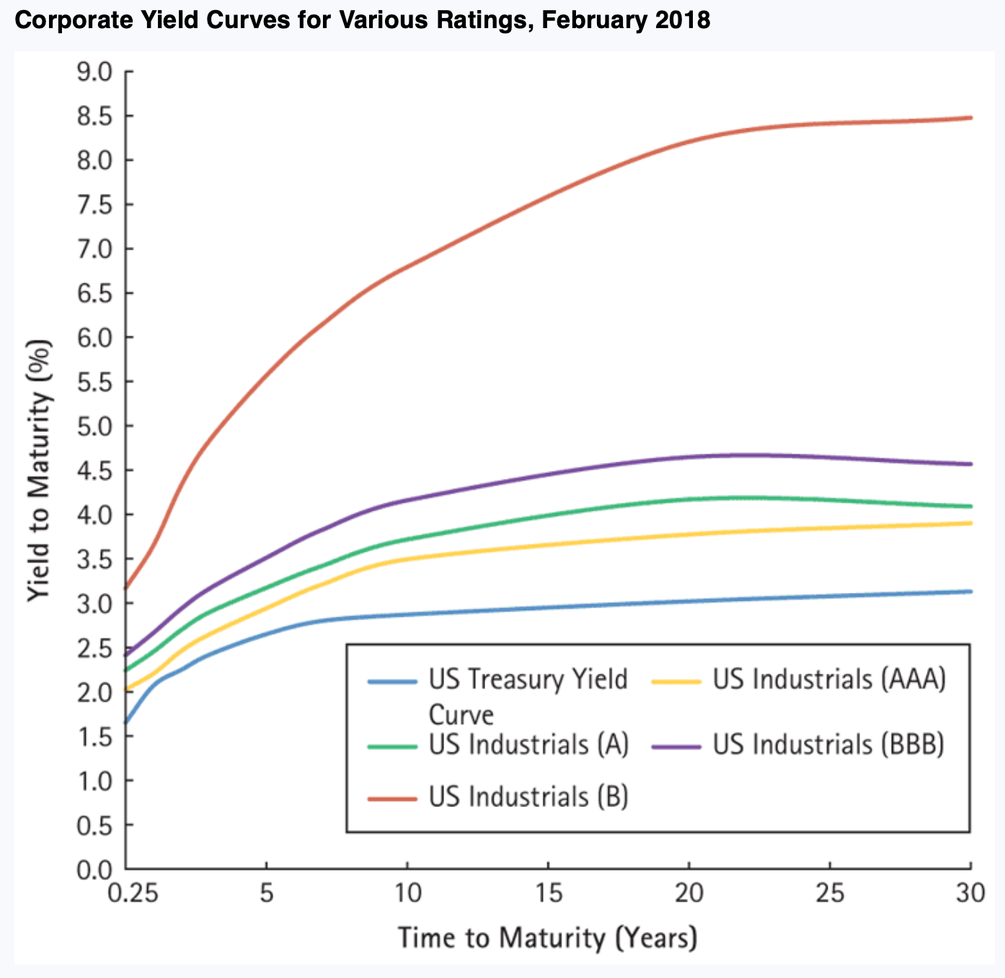
Credit spread
Credit spread is difference between YTM on corporate bond and risk-free rate on US Treasury of same maturity
Also called the “default spread”
Riskier firms pay higher spread [i.e., their cost of debt is higher]
Figure 6.6: Berk, Demarzo, and Harford, Fundamentals of Corporate Finance, 5th Ed.

Slide 26
Where to find bond prices, ratings, & yields?
No central location where bonds are traded
However, FINRA is trying to make it easier to find most recent trade price (and implied yield) on their website
https://www.finra.org/finra-data/fixed-income/about-cna-data
Let’s click the above link to see an example…

Slide 27
Outline of stock discussion
Motivation for valuing stocks
Difference between stocks & bonds
Using DCF to value stocks
Dividend-discount model
Total payout model
Discounted free cash flow model

Slide 28
Motivation for valuing stocks
Can help with personal investments
E.g., if Meta (i.e., Facebook) stock is trading at $85.32, should you buy it? Should you sell it? Intuitively, how do you make this decision?
Knowing how to value stocks will also help you see how positive NPV projects affect a company’s share price
E.g., if Apple were to announce tomorrow that it will produce an Apple car and its share price falls by 5% [which is about $50 billion drop in the total market value of its equity], what would that mean?

Slide 29
The difference between stocks & bonds
Stock is a form of ‘equity’
It provides ownership & (typically) control rights [How?]
It is not a liability that must be repaid; i.e., a firm’s failure to pay dividends does not result in the bankruptcy of the firm
This is different than bonds, which are a ‘debt’
Debt does not provide ownership or control rights
And coupons & face value must be paid; otherwise, the firm is bankrupt, and debtors can legally claim assets of the firm

Slide 30
How to value stocks
We do it like any other asset using DCF!
First, estimate the expected cash flows from owning it
Then, take present value using discount rate that reflects the return investors could get on investment of similar riskiness
If you own a stock, what are the possible cash flows?

Slide 31
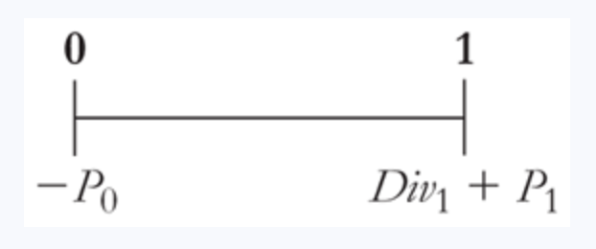
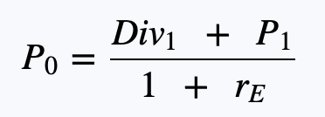
Consider investor that plans to sell in one year…
Equity cost of capital, r_{E}, is appropriate discount rate
And, expected cash flows are…
Buy at current price, P₀
Receive dividend of that year, Div₁
And sell one year from now at price P₁
So, it must be the case that…
Cost of buying, P₀, must equal present value of expected cash flows, Div₁ + P₁; otherwise, investors could profit by selling or buying the stock [Give example?]

Slide 32
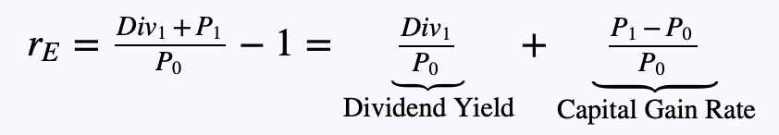
Breaking return into dividend yield & capital gain
Can rewrite equation to see that total return, r_{E}, has two parts:
Dividend yield = percentage return an investor expects to earn from the dividends paid by the stock over the next year
Capital gain rate = amount by which the selling price exceeds initial purchase price (i.e., capital gain, P₁ – P₀) as percentage of initial price
What would happen if return r_{E} is higher than return that can be earned elsewhere by taking same risk?

Slide 33
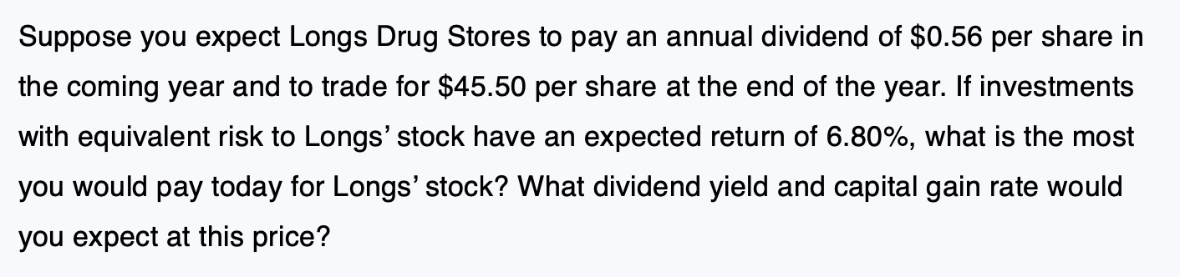
Practice question – Valuing a stock
Please take 10 minutes to answer the below question [which is Example 7.1 of the textbook]

Slide 34
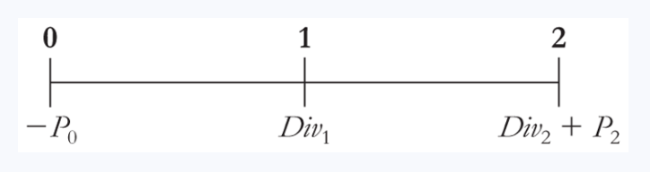
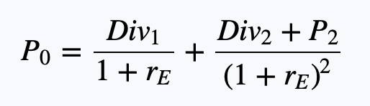
Now consider investor that plans to sell in 2 years…
Expected cash flows are now…
So, it must be the case that…
Does this mean that the two-year investor will value the stock differently than the one-year investor?

Slide 35
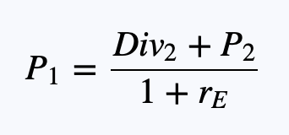
Comparing one-year & multi-year investor
While the two valuations seem different, one can show that the stock values of the two investors are the same…
Why? Because the one-year investor also cares about dividends and stock price in year 2 as they determine selling price in year 1, P₁
And if you plug this P₁ into the one-year valuation, you will see that it equals the valuation of the two-year investor [see textbook for math]

Slide 36

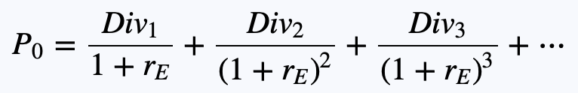
Dividend-discount model
Can repeat this to arrive at the dividend-discount model:
And, if you take it out forever…
In words, what is last equation saying the value of a stock equals?
Estimating dividends forever would be hard… what is a possible shortcut?

Slide 37
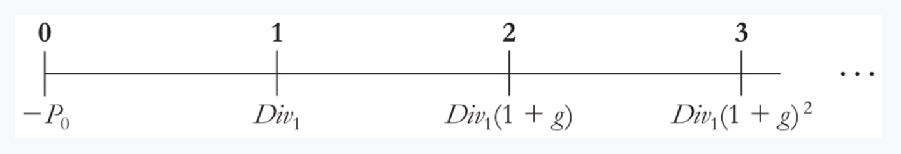

A special case – Constant dividend growth rate
Can assume dividends grow at constant rate g forever…
Then, value simplifies to…
Just used growing perpetuity present value formula [see Topic #2]

Slide 38
A more realistic case – Changing growth rates
Assuming a constant growth rate often not realistic for younger firms that do not yet pay dividends or ones that do not yet grow at a steady rate; for those firms, we:
Estimate dividends each year initially
Then, calculate expected future price after assuming the dividend growth rate eventually stabilizes to a constant value
See next slide for example…

Slide 39
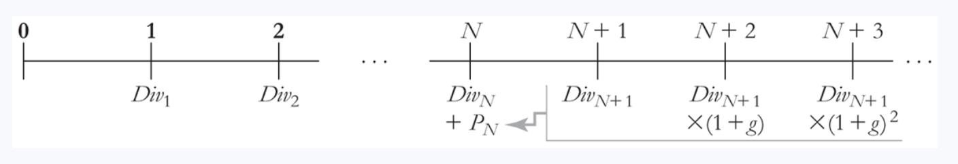

Changing growth rates [example]
If you estimate dividends up to year N+1 and then assume they grow at constant rate g after that…
Then, P_{N} is given by
And you can now apply dividend-discount model equation!

Slide 40
Dividend-discount model [Summary]
Can think of valuing stock as being done in two stages:
, where
Stage 1: Value of dividends over time period where they are not growing at constant rate
Stage 2: Value of dividends during period where they grow at constant rate, g

Slide 41
Group assignment – Warren Buffett Case [again]
Take 60 minutes to answer questions on Case #5 handout, which is again about the Warren Buffett acquisition of GEICO
This assignment will have you analyze whether the stock price being paid for GEICO is reasonable using the dividend-discount model
Upload answers as MS Excel, MS Word, or MS PowerPoint file to Canvas

Slide 42
Value drivers of the dividend-discount model
According to dividend-discount model, value of stock will:
Increase if firm can pay more dividends, all else equal
Increase if return demanded by investors falls, all else equal
Intuitively, what are things firms can do to achieve this?
Next up, what do you think are limitations of the dividend-discount model?

Slide 43
Limitations of the dividend-discount model
Cannot be used to value companies that don’t pay dividends [e.g., Meta, Amazon, and Google]
Tremendously hard to forecast dividends!
This is not like bonds, where coupons and face value payments are set by the initial terms of the bond issuance
And small change in assume growth rate, g, can matter a lot!
Given this, other DCF methods are needed…

Slide 44
The Total Payout Model
A second way to value a stock
Same idea, but now take PV of total payouts, including those coming from stock repurchases
An increasingly popular (and alternative) way companies pay out cash to stock investors; basically, firm uses cash to buy back its shares rather than pay dividends [e.g., Apple does this a lot]

Slide 45

The Total Payout Model [continued]
Take present value of all expected dividends and repurchases of the firm
To use this approach, you calculate:
Then, divide by total # of shares to get a per share value of those payments

Slide 46
The discounted free cash flow model
A third way to value a stock that we already saw in Topic #4!
To use this approach:
Take value of entire firm (not just equity) using DCF [How?]
Find total equity value by subtracting off value of debt
Then, divide by # of shares to get per share value of equity
This approach works for all firms, regardless of whether they pay dividends!

Slide 47
DCF model & the terminal value
Estimating FCFs out forever is not practical
So, we use a terminal value:
Terminal value = Present value of all FCF after year N, measured as of year N [This is just like the P_{N} in the dividend-discount model]
This V_{N} is the “terminal value”
$$Firm value={Cash}_{0}+\frac{{FCF}_{1}}{\left(1+r_{wacc}\right)}+…+\frac{{FCF}_{N}}{{\left(1+r_{wacc}\right)}^{N}}+\frac{V_{N}}{{\left(1+r_{wacc}\right)}^{N}}$$
And because it is measured as of year N, must still take present value

Slide 48
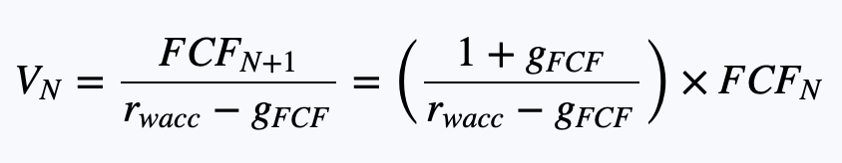
Estimating the terminal value
Typically assume FCFs grow at constant rate g_{FCF} beyond year N, which allows us to use growing perpetuity formula
The assumed growth rate, g_{FCF}, should…
Account for inflation
Not be higher that nominal growth rate of entire economy [Why?]

Slide 49
Key points to remember
Can use DCF model to value bonds & stocks
First, estimate the expected cash flows from owning the asset
Then, take present value using appropriate discount rate
Can also use market prices of bonds & stocks to infer what the required return is that each type of investor demands
E.g., used bond price to back out YTM and firm’s r_{D}
Likewise, while I did not show you this explicitly, you can use constant-dividend growth model to back out r_{E}

Slide 50
Exam information & advice
Main topics I wanted to discuss are now completed, and you have everything needed to complete the exam
Some quick exam tips [also see handout on Canvas]
Done on MyLab; due three weeks from last meeting
Open-book, open-notes; I recommend also using MS Excel
Strikingly like MyLab homework and quizzes
About 2.5 times longer than quiz; so, don’t wait until last second!

Slide 51
Informal feedback form [for my eyes only]
Honest feedback appreciated…
Helps me make course better for future cohorts
Helps me revise lectures & cases
Please complete the form now at:
https://docs.google.com/forms/d/e/1FAIpQLSf3eSQeGIICSTrP5ozzOaP9-PqJoXBLL38WB04AyezMWoKZcg/viewform?usp=sharing

Slide 52
Official feedback form [Wash. U.’s eyes only]
Please take 10 minutes now to complete the official course evaluations:
https://evals.wustl.edu
I’ll resume course once we have 80% response rate…

Slide 53
That’s it; feel free to e-mail with questions!
Again, my e-mail is: gormley@wustl.edu
I will also post complete slides
I hope you enjoyed the course!

Slide 54
With our remaining time… [for STL]
First, let’s take stock of what we’ve learned
Let’s do 30-minute group breakout session; discuss what you’ve learned and what questions your group has for me
After breakout, I’ll go over any questions posed by the class
Then, with any leftover time we have, I can cover how managers make two other important decisions:
Optimal mixture of debt & equity [i.e., capital structure]
Optimal payout policy

